Slide 1

OIL PRICE ESTIMATION
SUBASH J(S20190020253)
PRUDHVI RAJ CH(S20190020207)
VENKATA SIVA T(S20190020255))

Slide 2
MOTIVATION OF THE PROJECT
Oil price prediction is an important topic in economics which has spurred the interest of researchers over the years to develop better predictive models.
In our project we are using some oil price estimation techniques for predicting the prices accurately based on the historical data.

Slide 3
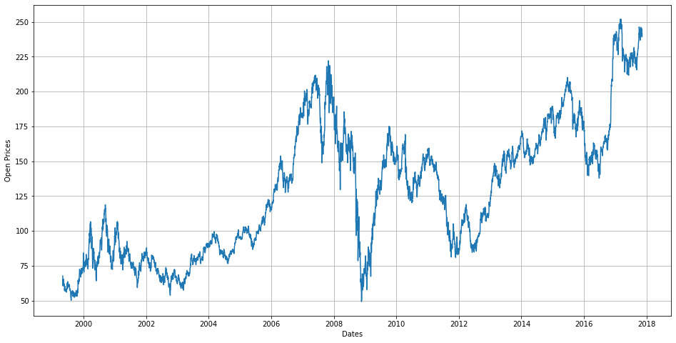
Historical 10 years data of Oil Price

Slide 4
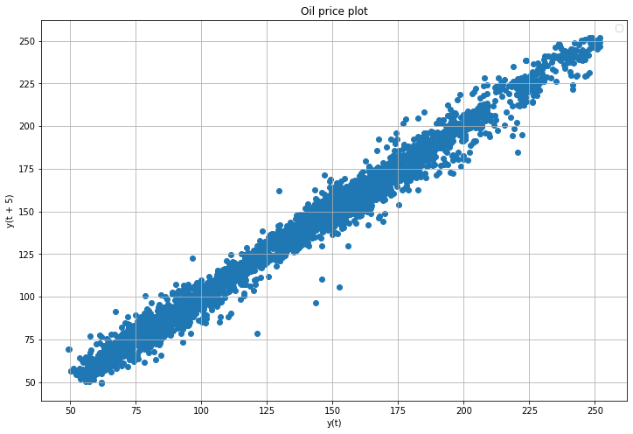
Auto correlation plot between present price and price after 5 days
We can observe from the figure that the price after 5 days from present depends on the current price of oil. Therefore this data is suitable for estimation.

Slide 5
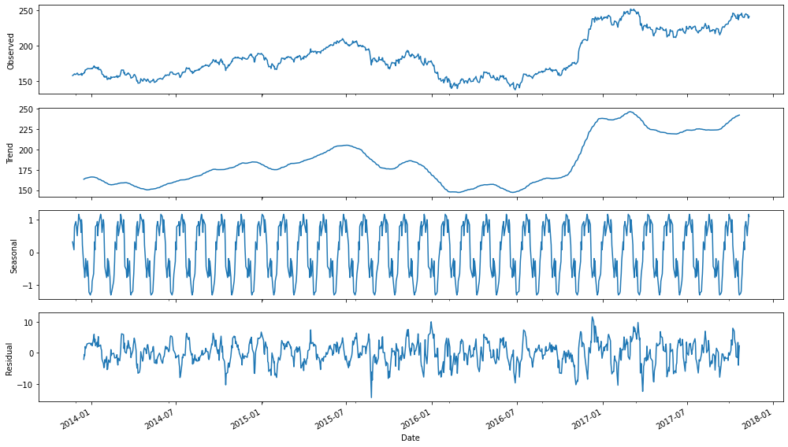
Seasonal decomposition of given data

Slide 6
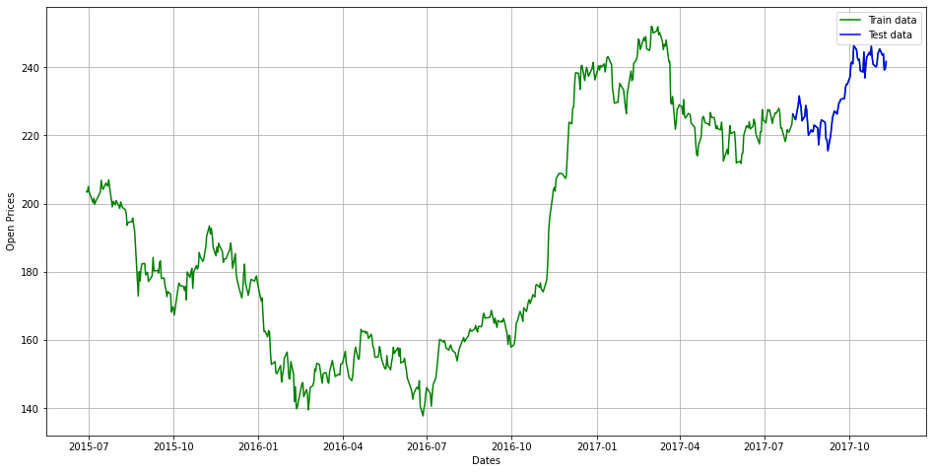
Test-Train split of Dataset

Slide 7
AR MODEL
The time period at t is impacted by the observation at various slots t-1, t-2, t-3, ….., t-k.
The impact of previous time spots is decided by the coefficient factor at that particular period of time.
This model calculates the regression of past time series and calculates the present or future values in the series in know as Auto Regression (AR) model.
Yt = β₁* y-₁ + β₂* yₜ-₂ + β₃ * yₜ-₃ + ………… + βₖ * yₜ-ₖ

Slide 8
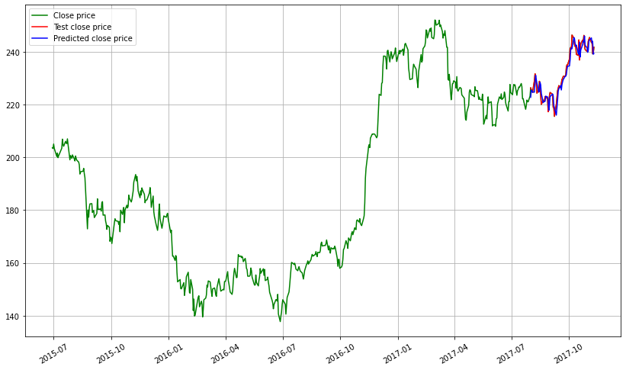
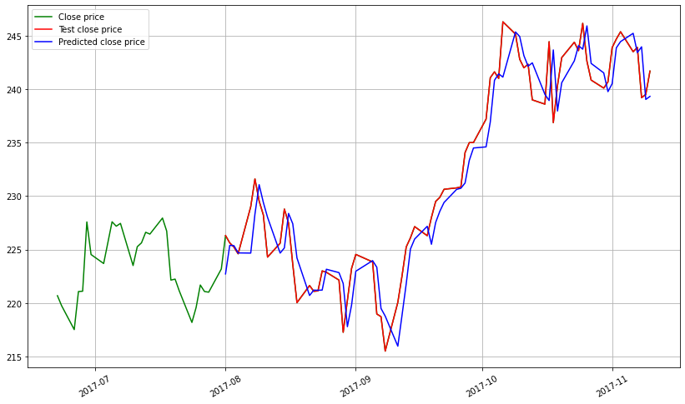
Plot of predicted estimates from AR Model
Zoomed in for last 600 values for better visualisation

Slide 9
MA MODEL
In MA model time period at t is impacted by the unexpected external factors at various slots t-1, t-2, t-3, ….., t-k. These unexpected impacts are known as Errors or Residuals.
The impact of previous time spots is decided by the coefficient factor α(alpha) at that particular period of time.
This model calculates the residuals or errors of past time series and calculates the present or future values in the series.
Yt = α₁* Ɛₜ-₁ + α₂ * Ɛₜ-₂ + α₃ * Ɛₜ-₃ + ………… + αₖ * Ɛₜ-ₖ

Slide 10
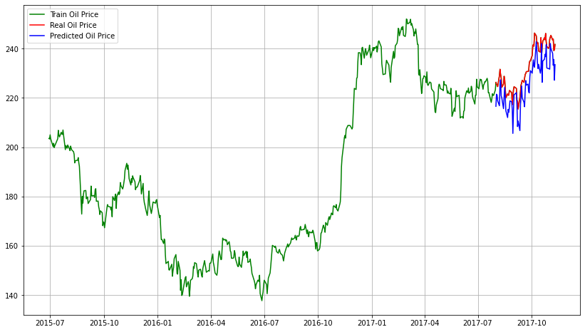
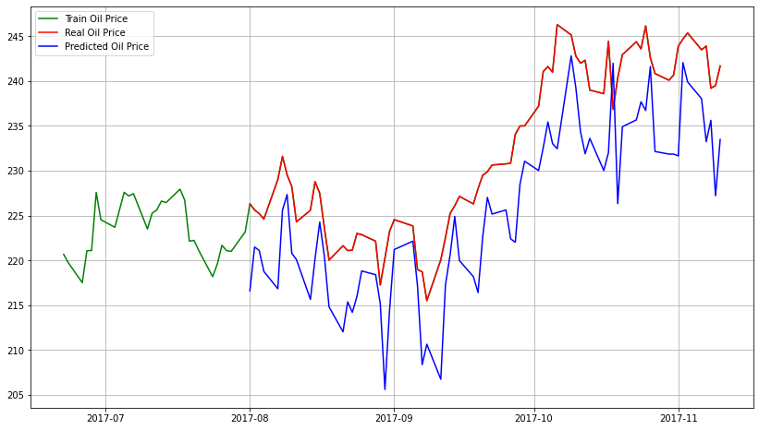
Plot of predicted estimates from MA Model
Zoomed in for last 600 values for better visualisation

Slide 11
ARMA MODEL
This is a model that is combined from the AR and MA models.
In this model, the impact of previous lags along with the residuals is considered for forecasting the future values of the time series.
Here β(beta) represents the coefficients of the AR model and α(alpha)represents the coefficients of the MA model.
Yt = β₁* yₜ-₁ + α₁* Ɛₜ-₁ + β₂* yₜ-₂ + α₂ * Ɛₜ-₂ + β₃ * yₜ-₃ + α₃ * Ɛₜ-₃ +………… + βₖ * yₜ-ₖ + αₖ * Ɛₜ-ₖ

Slide 12
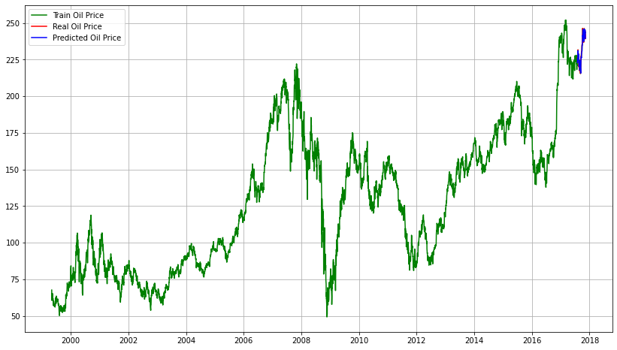
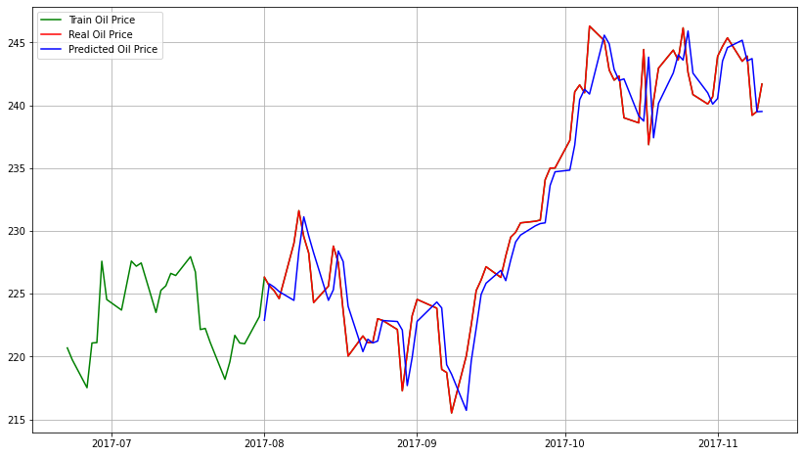
Plot of predicted estimates from ARMA Model
Zoomed in for last 600 values for better visualisation

Slide 13
ARIMA MODEL
ARIMA models have shown efficient capability to generate short-term forecasts.
ARIMA model uses time series data for identifying and estimating the stock price.
In ARIMA model, the future value of a variable is a linear combination of past values and past errors.
Yt is the actual value and t ε is the random error at t

Slide 14


Plot of predicted estimates from ARIMA Model
Zoomed in for last 600 values for better visualisation

Slide 15
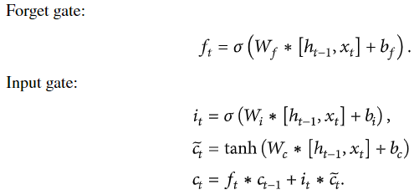
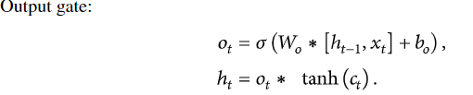
LSTM MODEL
LSTM is a special type of recurrent neural network (RNN).
RNN model can recycle the weight parameters of neurons and can effectively employ past data information for prediction.
Compared with the RNN model, the LSTM model introduces a cell state and uses the input gate,forget gate , and output gate .The three gates are used to maintain and control information.

Slide 16
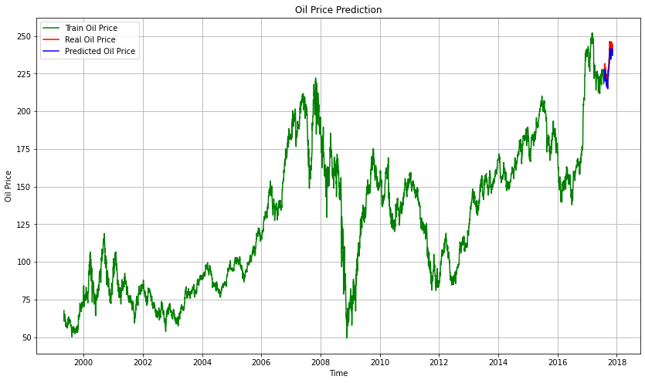
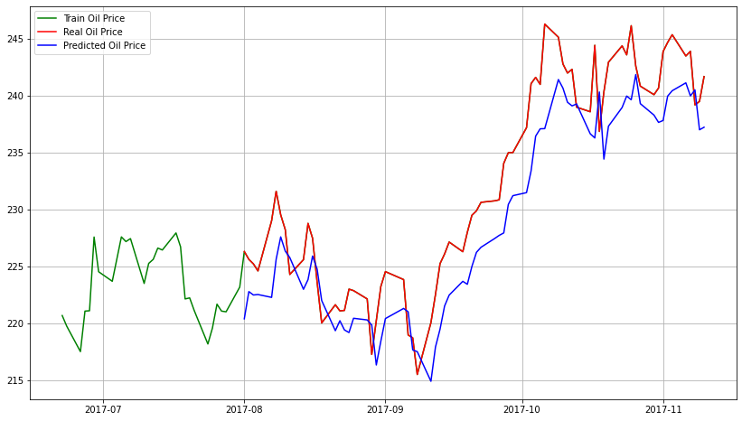
Plot of predicted estimates from LSTM Model
Zoomed in for last 600 values for better visualisation

Slide 17
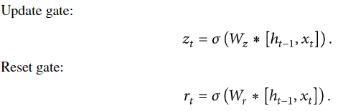
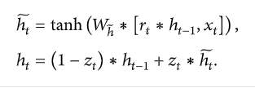
GRU MODEL
GRU is another type of RNN just like LSTM.
Compared with LSTM, GRU is simplified and only update gate and reset gate are introduced.
In GRU, the update (or input) gate decides how much input and previous output to be passed to the next cell and the reset gate is used to determine how much of the past information to forget.

Slide 18

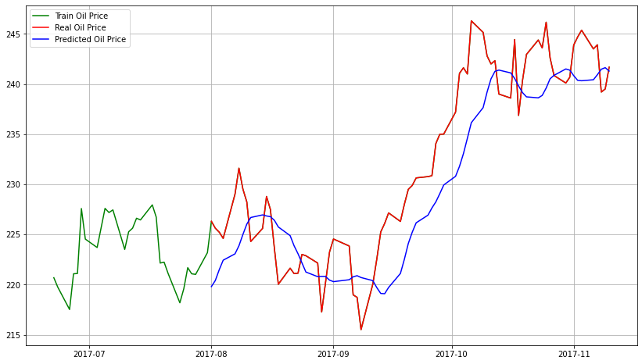
Plot of predicted estimates from GRU Model
Zoomed in for last 600 values for better visualisation

Slide 19
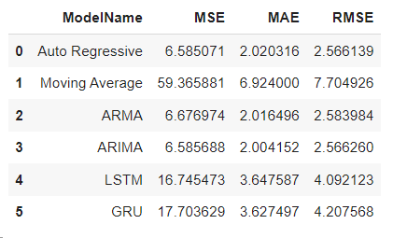
Numerical Analysis
MSE : Mean squared error (MSE) measures the distance between predicted and real values and is a very common metric to evaluate the performance of predictive methods .
MAE :Mean Absolute Error (MAE) refers to the magnitude of difference between the prediction of an observation and the true value of that observation.
RMSE :Root Mean Square Error (RMSE) is the standard deviation of the residuals (prediction errors).RMSE tells how concentrated the data is around the line of best fit.

Slide 20
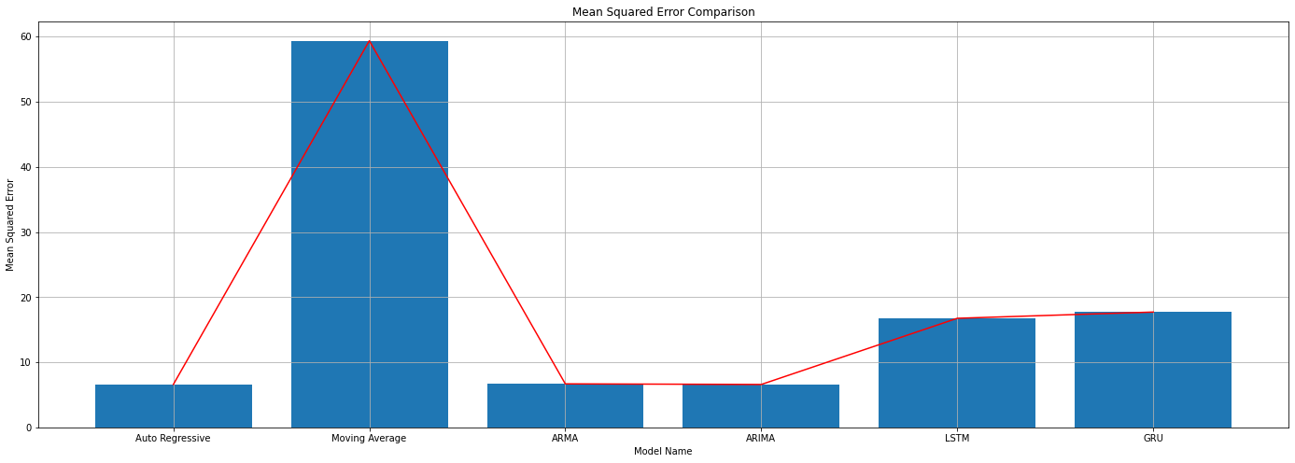
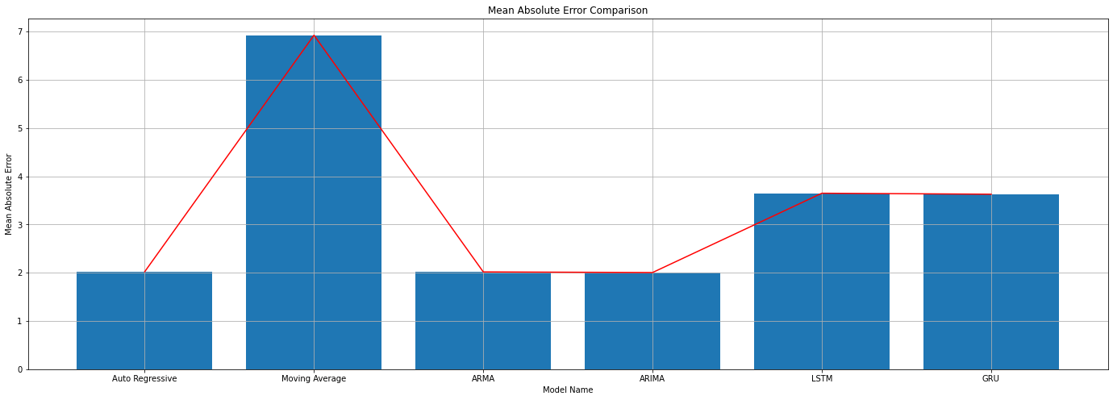
Comparison of different Estimators
Comparison of Mean Squared Error
Comparison of Mean Absolute Error

Slide 21
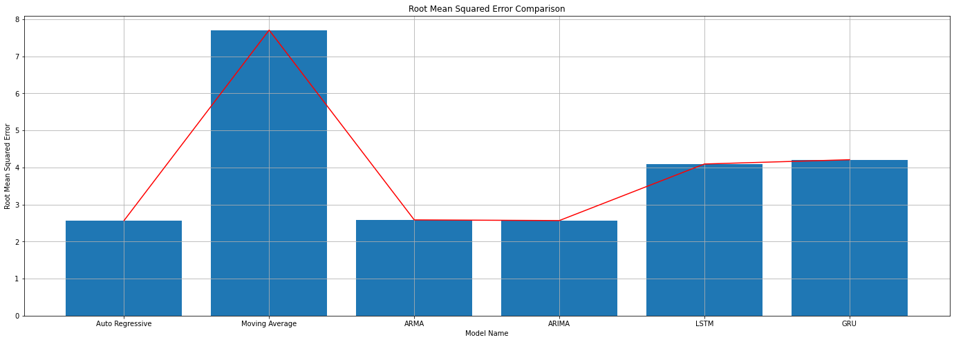
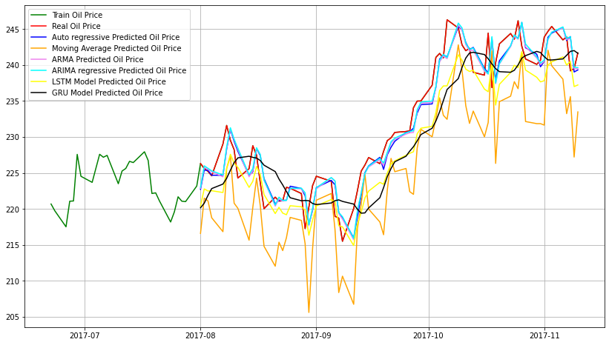
Comparison of different Estimators
Comparison of Root Mean Squared Error
Comparison of different estimator w.r.t real oil price

Slide 22
Inferences from comparisons
We can observe that the values of RMSE,MSE and MAE are least for AR, ARMA and ARIMA model. Since the error rate is less we can choose these a the best model from the comparisons.
Since we have taken a time series model, we estimate the value based on the previous 30 days value which we trained.
Auto arima model was carried to represent the order that we should take as params to get an effective model.
Bayesian Information Criterion and Maximum Likelihood Estimation is used in the ARIMA model to select the best parameters for our model.

Slide 23
REFERENCES
https://www.researchgate.net/publication/225877219_The_Cramer-Rao_Bound_for_Continuous-Time_Autoregressive_Parameter_Estimation_with_Irregular_Sampling
http://cas.et.tudelft.nl/~leus/papers/icassp09_2.pdf

Slide 24
Contribution
Subash J - Building Model for estimators, Visualisation and Report
Prudhvi Raj Chitta - Numerical Analysis, Comparison and PPT
Venkata Siva Tanari - Dataset Preprocessing and Understanding Theory
THANK YOU

Slide 25
THANK YOU

